Slide 1
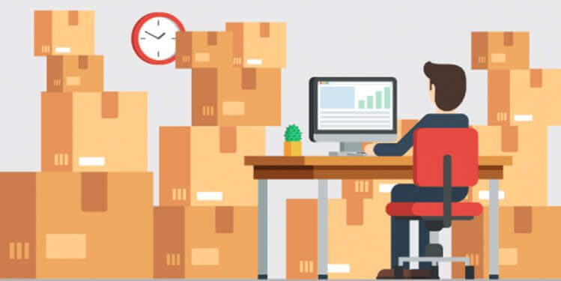
Lecture 3 Inventory
IPE 3401 – Industrial and Operational Management

Slide 2
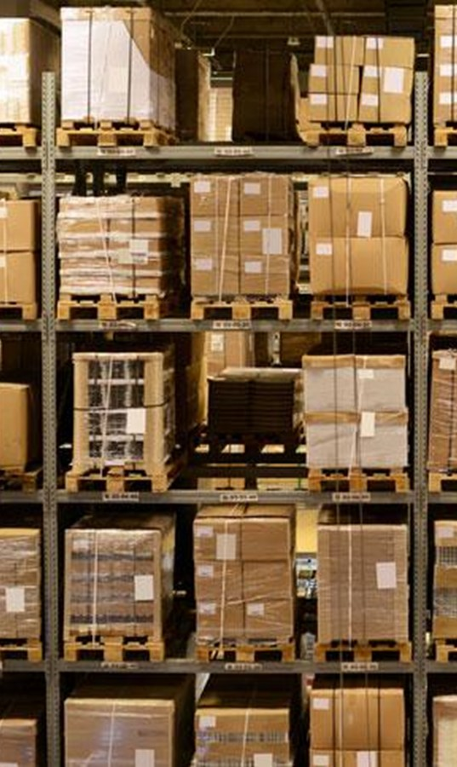
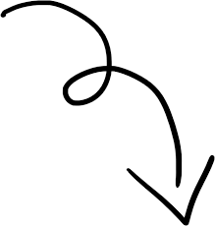
What is Inventory?
A stock or store of goods
Independent Demand Items
Demand not related to any other item and primarily influenced by market conditions
Dependent Demand Items
Demand for an item is influenced by the demand of another item
A “typical” firm invests in inventory roughly
30% of its current assets and 90% of its working capital

Slide 3
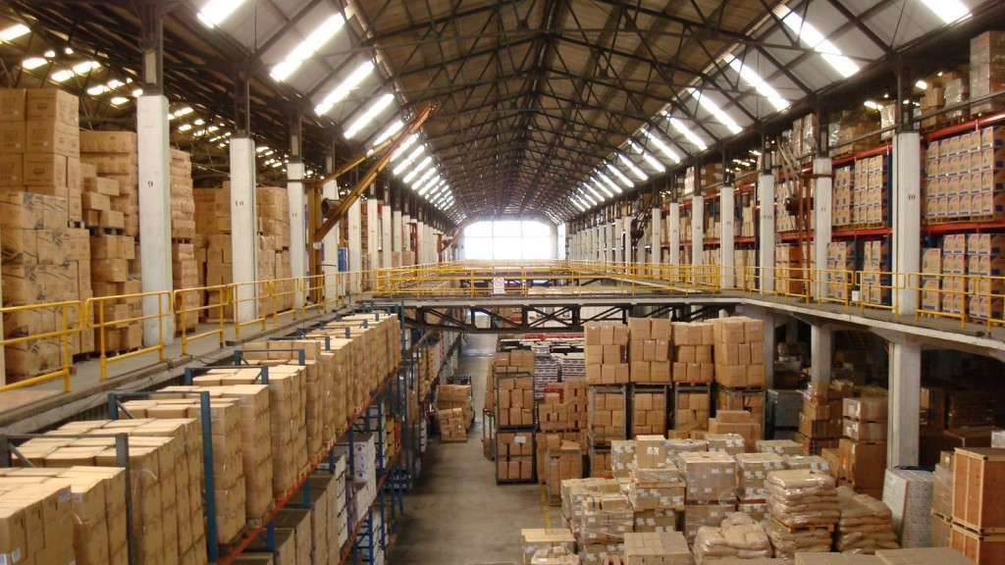
Typical Inventory

Slide 4
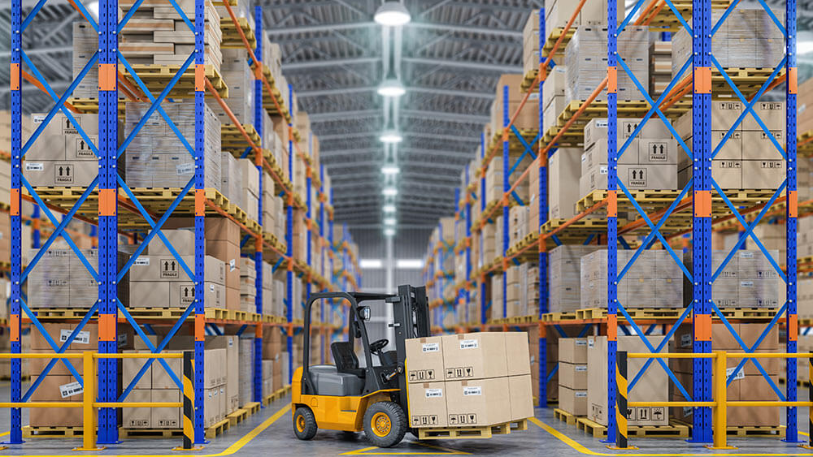
Typical Inventory

Slide 5
Fill logistics pipeline - resupply time
Display goods to potential customers
Avoid loss of sales or high cost of backorders
Economies of batch production
Why do we need inventory?
Bi-product from production smoothing
Unpredictable or unreliable vendors
Hedge against poor quality
Buffer for imbalanced production lines
Safety stock against random demands or uncertain lead-times
Buffer for machine downtimes

Slide 6
Conflicting Objectives of Teams
Area | Responsibility | Inventory Goal | Desired Inventory Level
Marketing | Sell the product | Good customer service | High
Production | Make the product | Efficient lot sizes | High
Purchasing | Buy required material | Low unit cost | High
Finance | Provide working capital | Efficient use of capital | Low
Warehousing | Store the product | Efficient use of space | Low
Engineering | Design the product | Avoid obsolescence | low

Slide 7
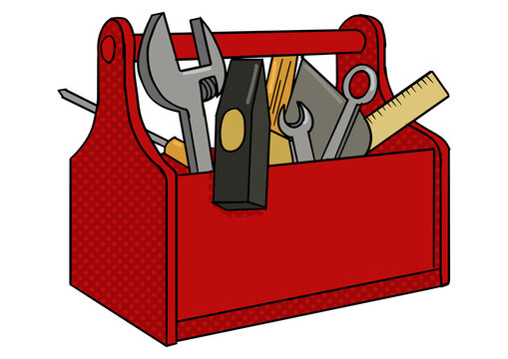
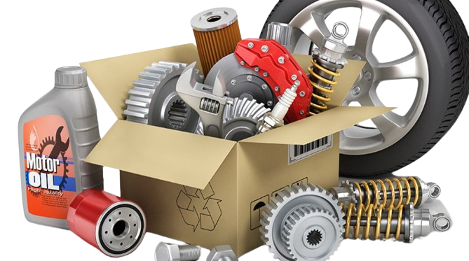
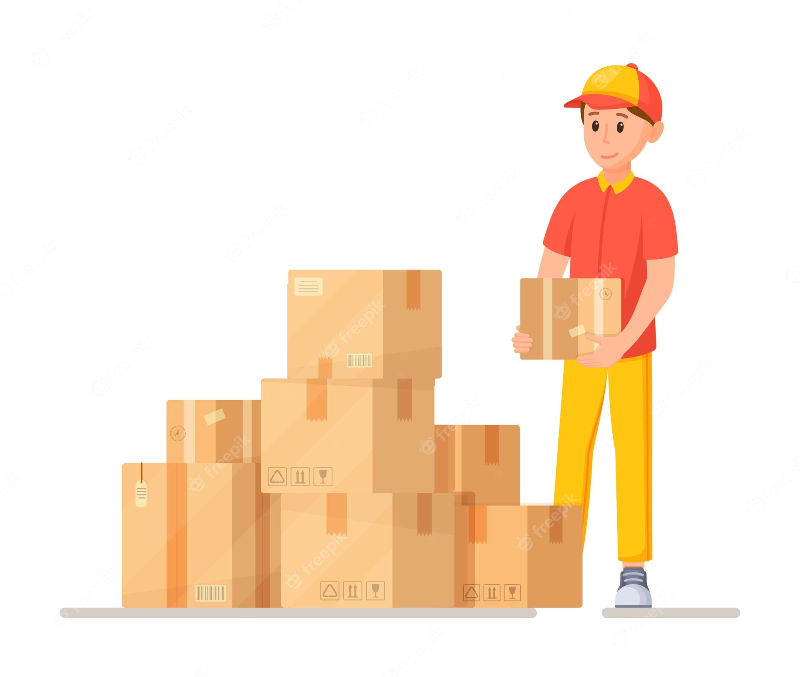
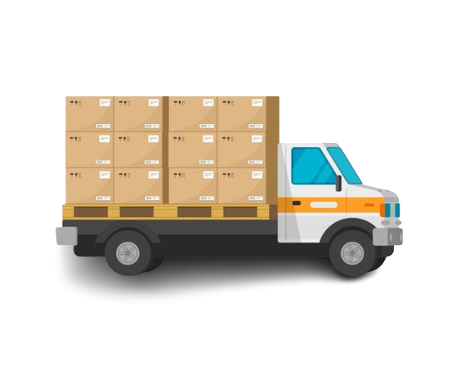

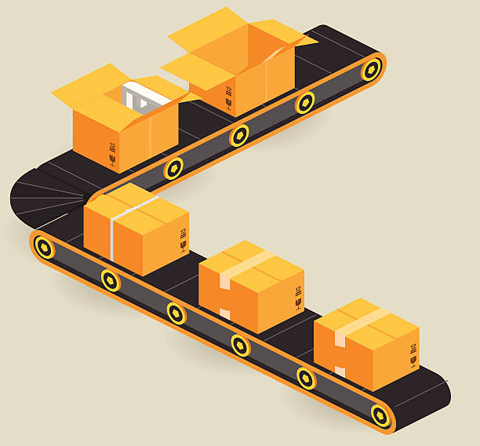
Types of Inventory
Raw Material
Material needing further processing
Components that go into the product as is
Supplies such as glue, screws, ink, thread
Dependent demand
Work in Process (WIP)
Inventory in the production system waiting to be processed or assembled and may include semi-finished products
Partially complete goods
Dependent demand
Finished Goods
Output of the production process or end items
Demand is usually independent
Finished goods from one manufacturing plant may be raw material for another
Tools and Supplies
Maintenance and Repairs Inventory
In-transit Inventory

Slide 8
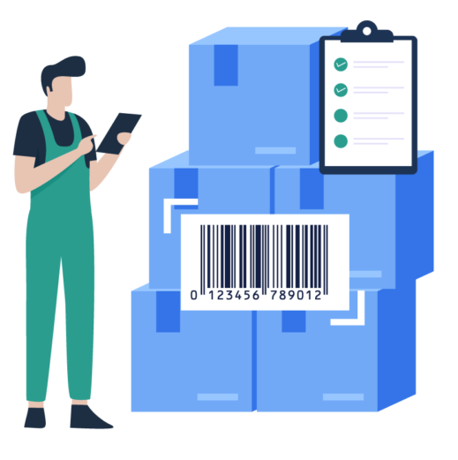
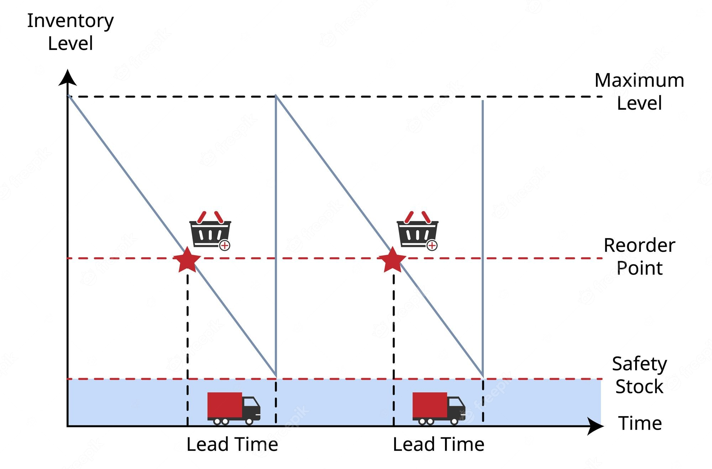
Inventory Management
Two basic functions
Establish a system for tracking items in inventory
Make decisions about
When to order
How much to order

Slide 9
Inventory
Costs
Procurement
Cost
The amount paid to buy the inventory
Holding (carrying) Cost
Cost to carry an item in inventory for a length of time, usually a year
Inventory Cost
Ordering Cost
Costs of ordering and receiving inventory
Setup Cost
The costs involved in preparing equipment for a job
Analogous to ordering costs
Shortage Cost
Costs resulting when demand exceeds the supply of inventory

Slide 10
Inventory Counting Systems
Periodic System
Physical count of items in inventory made at periodic intervals
Vulnerable as inventory state may change drastically between the counting intervals
Perpetual Inventory System
System that keeps track of removals from inventory continuously, thus monitoring current levels of each item
An order is placed when inventory drops to a predetermined minimum level
Universal Product Code (UPC) or Bar-code is implemented to track each item
Point-of-sale (POS) system is required

Slide 11
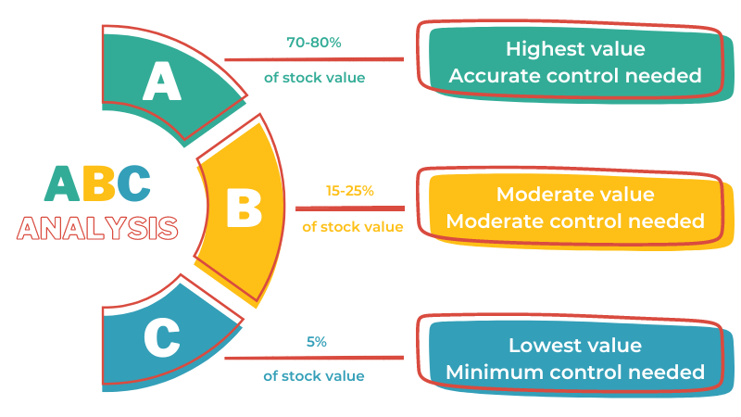
Inventory Classification System
15 %
35 %
50 %

Slide 12
Steps of Solving ABC Classification Problem
1
For each item, multiply inventory volume by unit price to get the inventory value
2
Arrange inventory values in descending order
3
Club top 15% together as A class, next 35% (cumulative 50% including item marginally surpassing 50%) as B class, and bottom 50% as C class

Slide 13
Example of ABC Classification Problem
A manager has obtained a list of unit costs and estimated annual demands for 10 inventory items and now wants to categorize the items on ABC basis. Solve the problem for him.
Item Number | Annual Demand | Unit Cost ($)
1 | 25 | 220
2 | 25 | 330
3 | 24 | 200
4 | 15 | 190
5 | 7 | 750
6 | 10 | 800
7 | 12 | 210
8 | 11 | 900
9 | 80 | 90
10 | 10 | 500

Slide 14
Solution of
ABC Classification Problem
Step 1
For each item, multiply inventory volume by unit price to get the inventory value
Item Number | Annual Demand | Unit Cost ($) | Annual Inventory Value ($)
1 | 25 | 220 | 5,500
2 | 25 | 330 | 8,250
3 | 24 | 200 | 4,800
4 | 15 | 190 | 2,850
5 | 7 | 750 | 5,250
6 | 10 | 800 | 8,000
7 | 12 | 210 | 2,520
8 | 11 | 900 | 9,900
9 | 80 | 90 | 7,200
10 | 10 | 500 | 5,000

Slide 15
Solution of
ABC Classification Problem
Step 2
Arrange inventory values in descending order
A
B
C
Item Number | Annual Inventory Value ($) | % | Running % | Class
8 | 9,900 | 17% | 17% | A
2 | 8,250 | 14% | 31% | B
6 | 8,000 | 14% | 45% | B
9 | 7,200 | 12% | 57% | B
1 | 5,500 | 9% | 66% | C
5 | 5,250 | 9% | 75% | C
10 | 5,000 | 8% | 83% | C
3 | 4,800 | 8% | 91% | C
4 | 2,850 | 5% | 96% | C
7 | 2,520 | 4% | 100% | C
Total | 59,270 | 100%

Slide 16
Solution of
ABC Classification Problem
Step 3
Club top 15% together as A class, next 35% as B class and bottom 50% as C class
Item Number | Annual Inventory Value ($) | Percentage | Running Percentage | Classification
8 | 9,900 | 17% | 17% | A
2 | 8,250 | 14% | 31% | B
6 | 8,000 | 14% | 45% | B
9 | 7,200 | 12% | 57% | B
1 | 5,500 | 9% | 66% | C
5 | 5,250 | 9% | 75% | C
10 | 5,000 | 8% | 83% | C
3 | 4,800 | 8% | 91% | C
4 | 2,850 | 5% | 96% | C
7 | 2,520 | 4% | 100% | C
An item marginally surpassing cumulative 50% is to be considered as B class

Slide 17
Reducing production lead time by using more efficient manufacturing methods
Developing simpler product designs with fewer parts
Using standardized parts
The Need for
Improving the forecasting of demand
Restructuring the supply chain so that the supplier holds the inventory
Inventories
Can be Reduced by
Utilizing reliable suppliers and improving the relationships in the supply chain
Using preventive maintenance on equipment and machines
Reducing supplier delivery lead times and increasing delivery reliability

Slide 18
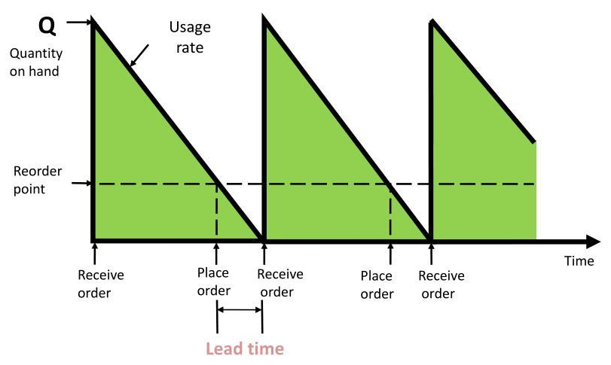
The Inventory Cycle
Order Size, Q
Usage rate
Order Size, Q
350 Units
Usage rate
50 Units per day
Lead time
2 days
Reorder point
100 units (2 days supply)
Quantity on Hand
Reorder Point
0
5
7
12
14
Day
Receive Order
Place Order
Receive Order
Place Order
Receive Order
Lead Time

Slide 19
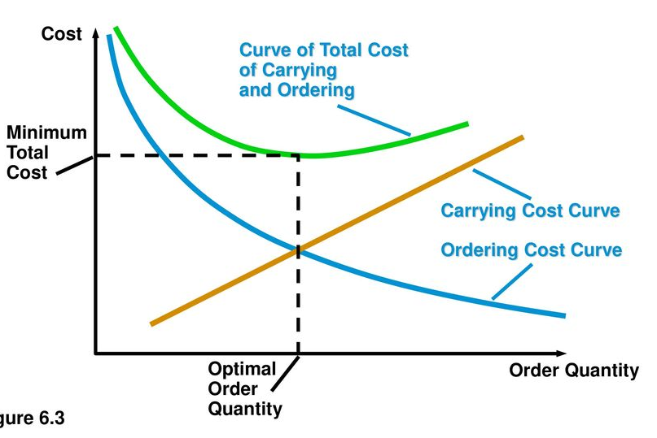
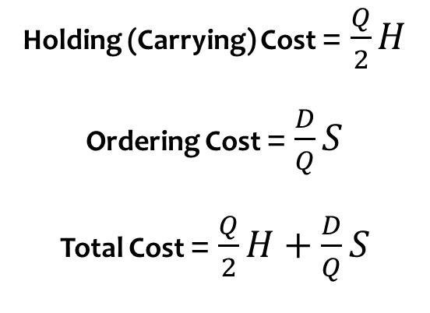
Inventory Cost Curves
Cost
Total Cost
Curve
Holding (Carrying) Cost = $\frac{Q}{2}H$
Ordering Cost = $\frac{D}{Q}S$
Total Cost =$\frac{Q}{2}H+\frac{D}{Q}S$
Minimum Total Cost
Holding (carrying) Cost Curve
Ordering Cost Curve
Q = Order Quantity
H = Holding Cost per Unit per Year
D = Demand per Year
S = Ordering Cost per Order
Optimal Order Quantity
Order Quantity

Slide 20
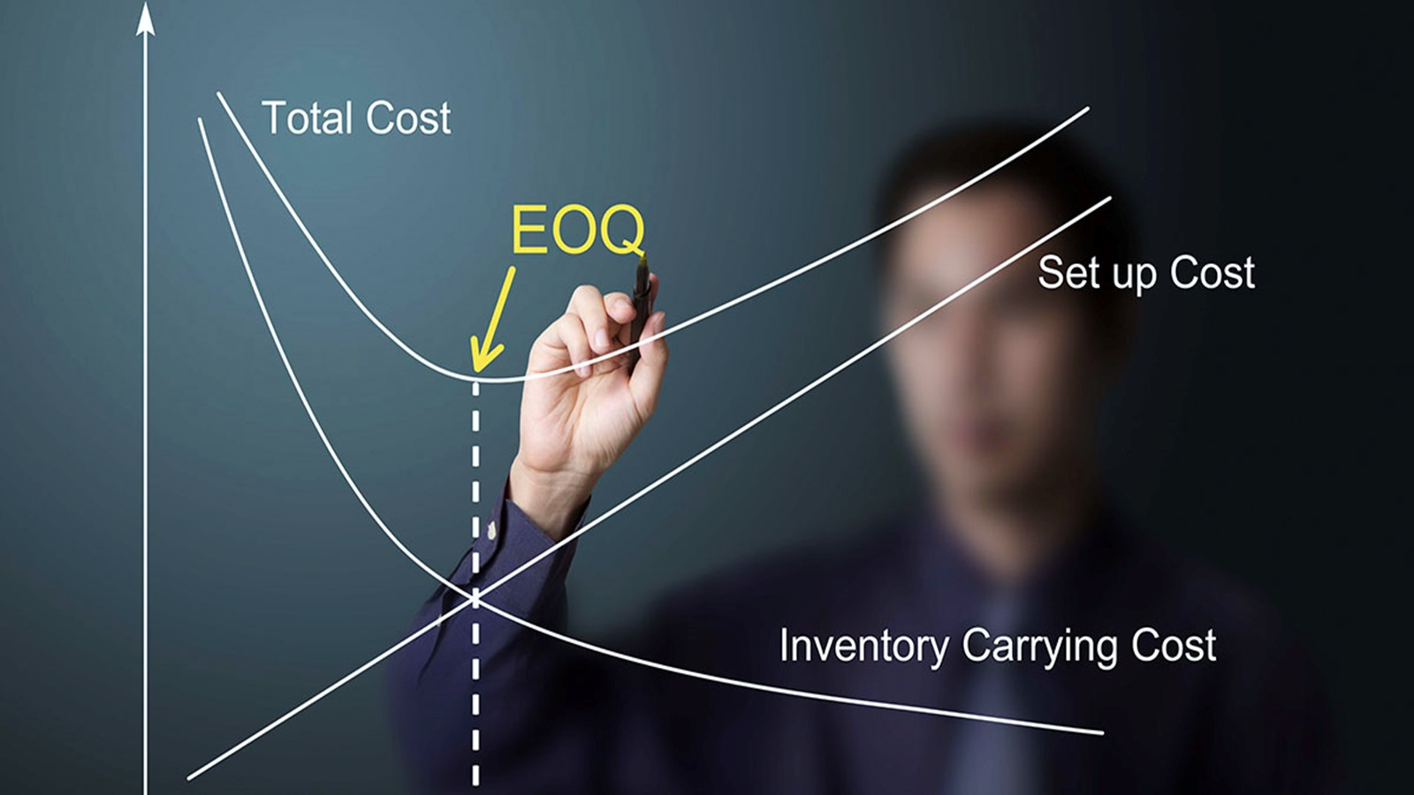
Economic Order Quantity (EOQ)
The economic order quantity (EOQ) refers to the ideal order quantity a company should purchase in order to minimize its inventory costs, such as holding costs, shortage costs, and order costs

Slide 21
Assumptions of EOQ
1
2
3
Only one product is involved
Annual demand requirements are known
Demand is spread evenly throughout the year i.e., the demand rate is constant
4
5
6
Lead time is known and constant
Each order is received in a single delivery
There are no quantity discounts

Slide 22

Deriving EOQ
Using calculus, we take the derivative of the total cost function and set the derivative (slope) equal to zero and solve for Q
$EOQ=\frac{d}{dQ}\left(Total Cost\right)=0$
$⇒\frac{d}{dQ}\left(\frac{Q}{2}H+\frac{D}{Q}S\right)=0$
$⇒\frac{H}{2}−\frac{DS}{Q^{2}}=0$
$$⇒Q= \sqrt{\frac{2DS}{H}}$$
EOQ

Slide 23
Example 1: EOQ
A local distributor for a national tire company expects to sell approximately 9,600 steel-belted radial tires of a certain size and thread design next year. Annual carrying cost is $16 per tire, and ordering cost is $75. The distributor operates 288 days a year.
a. What is the EOQ?
b. How many times per year does the store reorder?
c. What is the length of an order cycle?
d. What is the total annual cost if the EOQ quantity is ordered?

Slide 24
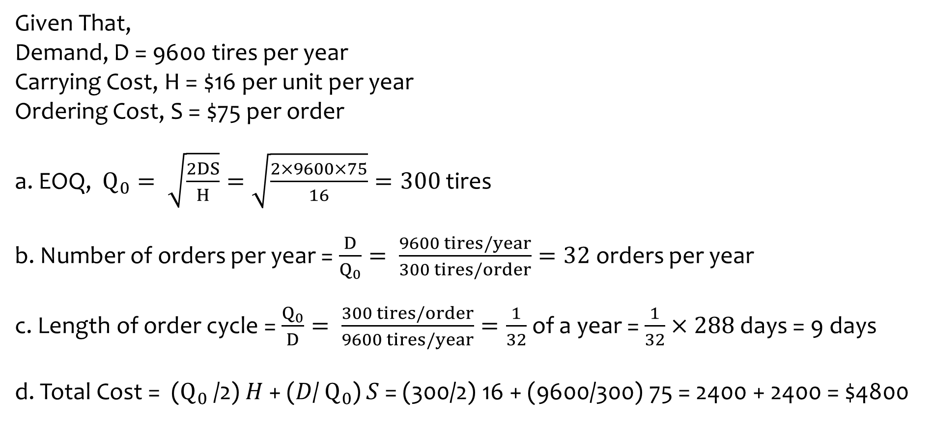
Solution of Example 1: EOQ
Given That,
Demand, D = 9600 tires per year
Carrying Cost, H = $16 per unit per year
Ordering Cost, S = $75 per order
a. EOQ, $Q_{0}= \sqrt{\frac{2DS}{H}}=\sqrt{\frac{2×9600×75}{16}}=300$ tires
b. Number of orders per year = $\frac{D}{Q_{0}}= \frac{9600 tires/year}{300 tires/order}=32$ orders per year
c. Length of order cycle = $\frac{Q_{0}}{D}= \frac{300 tires/order}{9600 tires/year}=\frac{1}{32}$ of a year = $\frac{1}{32}×288$ days = 9 days
d. Total Cost = ($Q_{0}$/2) 𝐻 + (𝐷/ $Q_{0}$) 𝑆 = (300/2) 16 + (9600/300) 75 = 2400 + 2400 = $4800

Slide 25
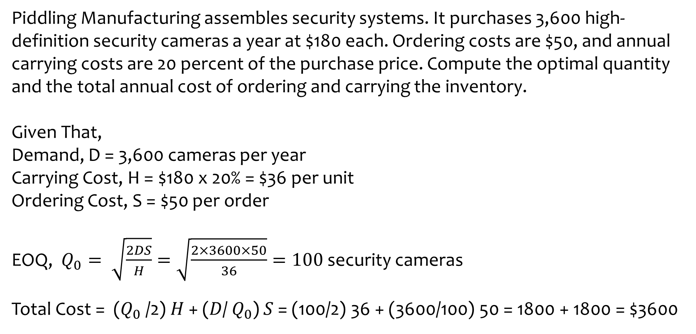
Example 2: EOQ
Piddling Manufacturing assembles security systems. It purchases 3,600 high-definition security cameras a year at $180 each. Ordering costs are $50, and annual carrying costs are 20 percent of the purchase price. Compute the optimal quantity and the total annual cost of ordering and carrying the inventory.
Given That,
Demand, D = 3,600 cameras per year
Carrying Cost, H = $180 x 20% = $36 per unit
Ordering Cost, S = $50 per order
EOQ, $Q_{0}= \sqrt{\frac{2DS}{H}}=\sqrt{\frac{2×3600×50}{36}}=100$ security cameras
Total Cost = ($Q_{0}$/2) 𝐻 + (𝐷/ $Q_{0}$) 𝑆 = (100/2) 36 + (3600/100) 50 = 1800 + 1800 = $3600

Slide 26
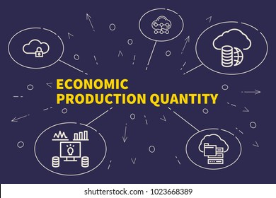
EPQ is the batch size that a manufacturer produces periodically to satisfy a certain demand and minimize the production cost.

Slide 27
Assumptions of EPQ
1
2
3
Only one product is involved
Annual demand requirements are known
Consumption rate is constant; consumption occurs continuously
4
5
6
Production rate is constant; production occurs periodically
Lead time is known and constant
There are no quantity discounts

Slide 28
Cycle of Production and Consumption
Cumulative Production
Inventory on Hand
Quantity
Production and Consumption
Only Consumption
Production and Consumption
Only Consumption
Production Run Size (or EPQ)
Maximum Inventory Level
Day
2
5
7
10

Slide 29
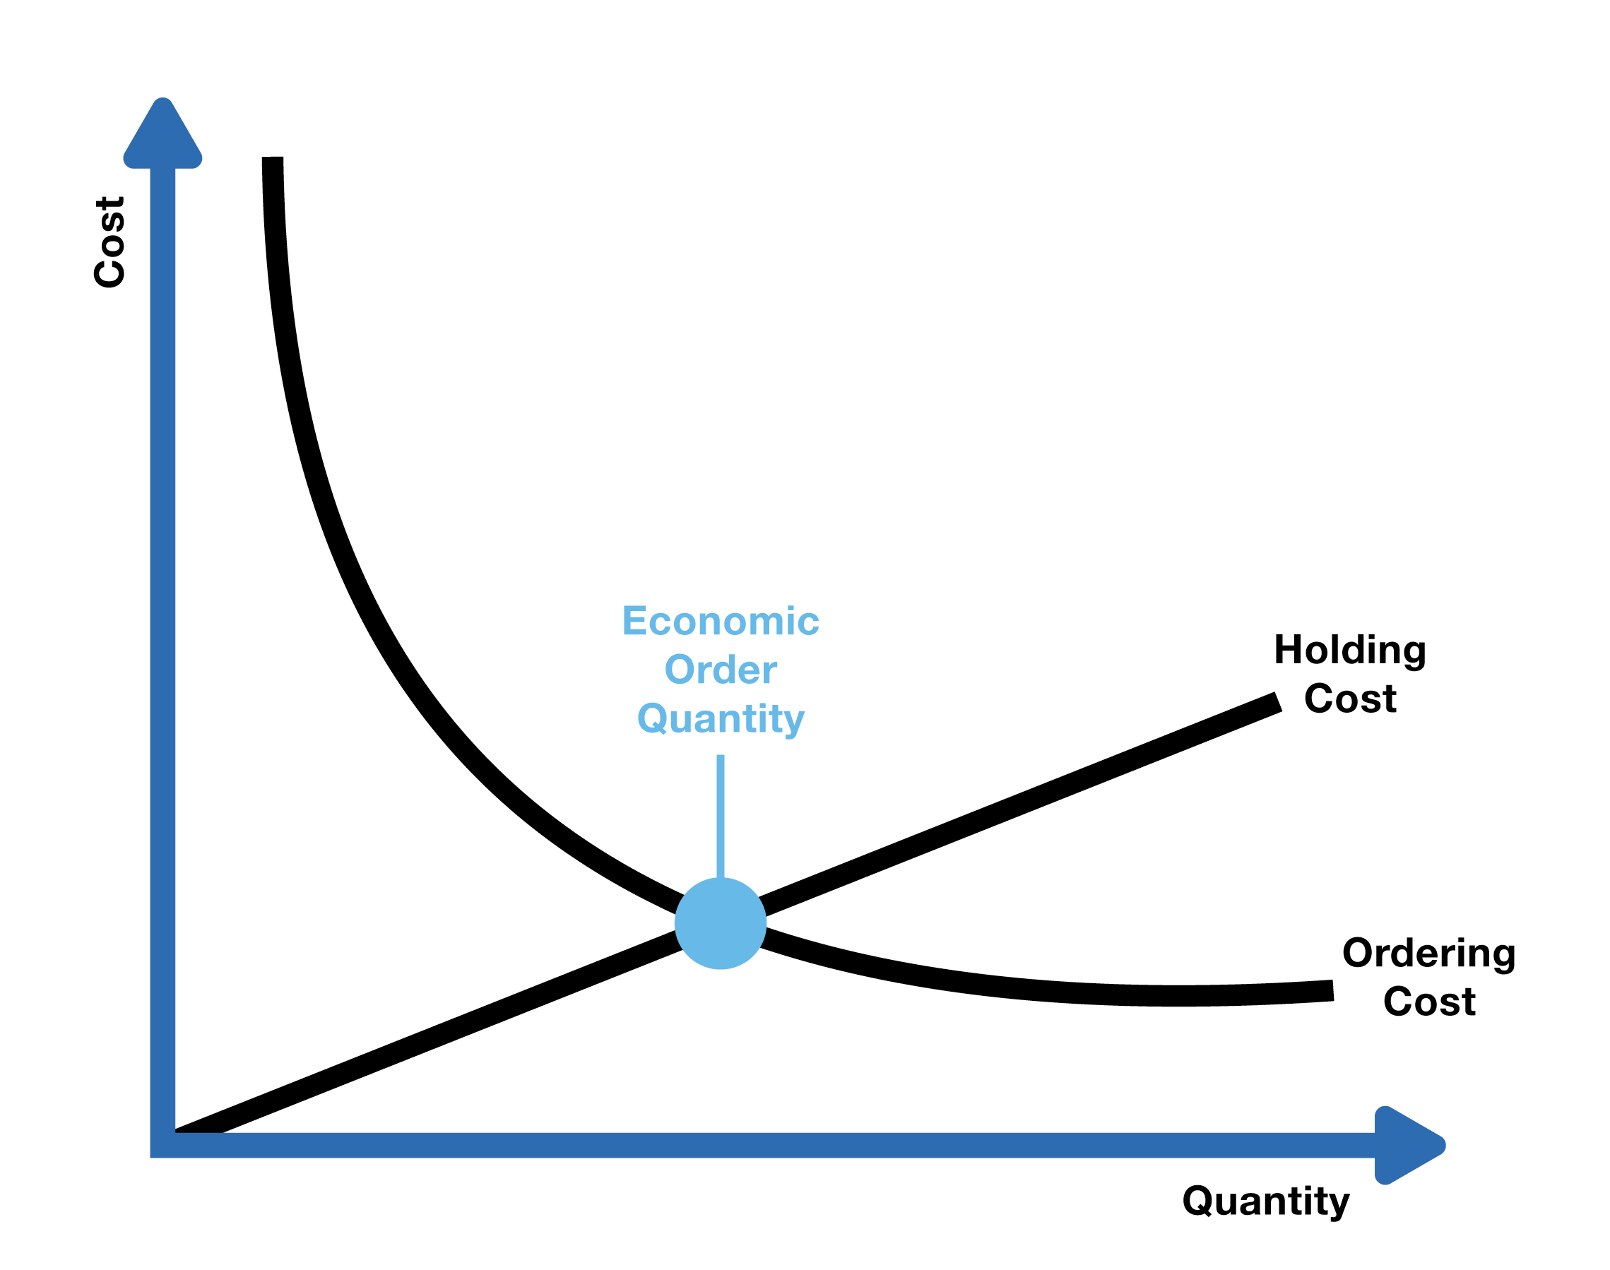
Economic Production Quantity Model
Cost
EPQ
Holding Cost
Q = No. of pieces per production run
p = Daily production rate
H = Holding cost per unit per year
d = Daily demand/usage rate
t = Length of the production run in days
Setup Cost
Quantity
Condition of Finding EPQ
Holding Cost = Setup Cost

Slide 30
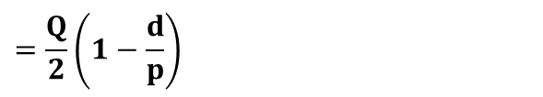



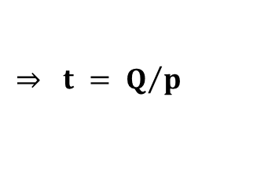

Economic Production Quantity Model
No. of pieces per production run, Q
Daily production rate
Total used Length of the production run in days
Q = No. of pieces per production run
p = Daily production rate
H = Holding cost per unit per year
d = Daily demand/usage rate
D = Annual Demand
t = Length of the production run in days
S = Setup cost per production run
= x
$$⇒ Q =p×t$$
$$⇒ t = Q/p$$
Maximum inventory level
Total produced during the production run
Total used during the production run
= –
$= pt – dt$ $=p\left(\frac{Q}{p}\right) −d\left(\frac{Q}{p}\right)=Q\left(1−\frac{d}{p}\right)$
Average inventory level
= (Maximum inventory level)/2
$$=\frac{Q}{2}\left(1−\frac{d}{p}\right)$$
Annual inventory holding cost
Average
inventory level
Holding cost per unit per year
$$=\frac{Q}{2}\left(1−\frac{d}{p}\right)×H$$
Annual Production Setup cost
$$=\frac{D}{Q}×S$$
= x

Slide 31
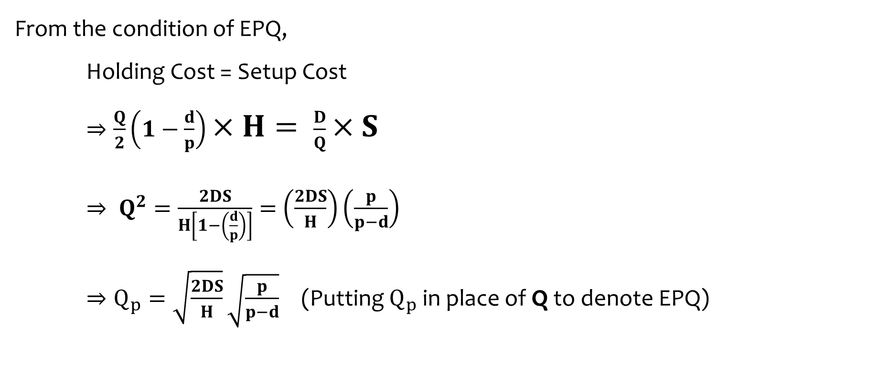
Economic Production Quantity Model
Q = No. of pieces per production run
p = Daily production rate
H = Holding cost per unit per year
d = Daily demand/usage rate
D = Annual Demand
t = Length of the production run in days
S = Setup cost per production run
From the condition of EPQ,
Holding Cost = Setup Cost
$⇒\frac{Q}{2}\left(1−\frac{d}{p}\right)×H= \frac{D}{Q}×S$
$⇒ Q^{2}=\frac{2DS}{H\left[1−\left(\frac{d}{p}\right)\right]}=$ $\left(\frac{2DS}{H}\right)\left(\frac{p}{p−d}\right)$
$⇒Q_{p}=\sqrt{\frac{2DS}{H}}\sqrt{\frac{p}{p−d}}$ (Putting $Q_{p}$in place of Q to denote EPQ)

Slide 32

Economic Production Quantity Model
Equations
Economic Production Quantity,${ Q}_{p}=\sqrt{\frac{2DS}{H}}\sqrt{\frac{p}{p−d}}$
Cycle Time $=\frac{{ Q}_{p}}{d}$
Run Time $=\frac{{ Q}_{p}}{p}$
Maximum Inventory Level, $I_{max}={ Q}_{p}\left(1−\frac{d}{p}\right)$

Slide 33
Example 3: EPQ
A toy manufacturer uses 48,000 rubber wheels per year for its popular dump truck series. The firm makes its own wheels, which it can produce at a rate of 800 per day. The toy trucks are assembled uniformly over the entire year. Carrying cost is $1 per wheel a year. Setup cost for a production run of wheels is $45. The firm operates 240 days per year. Determine the –
a. Optimal run size. b. Minimum total annual cost for carrying and setup. c. Cycle time for the optimal run size. d. Run time

Slide 34
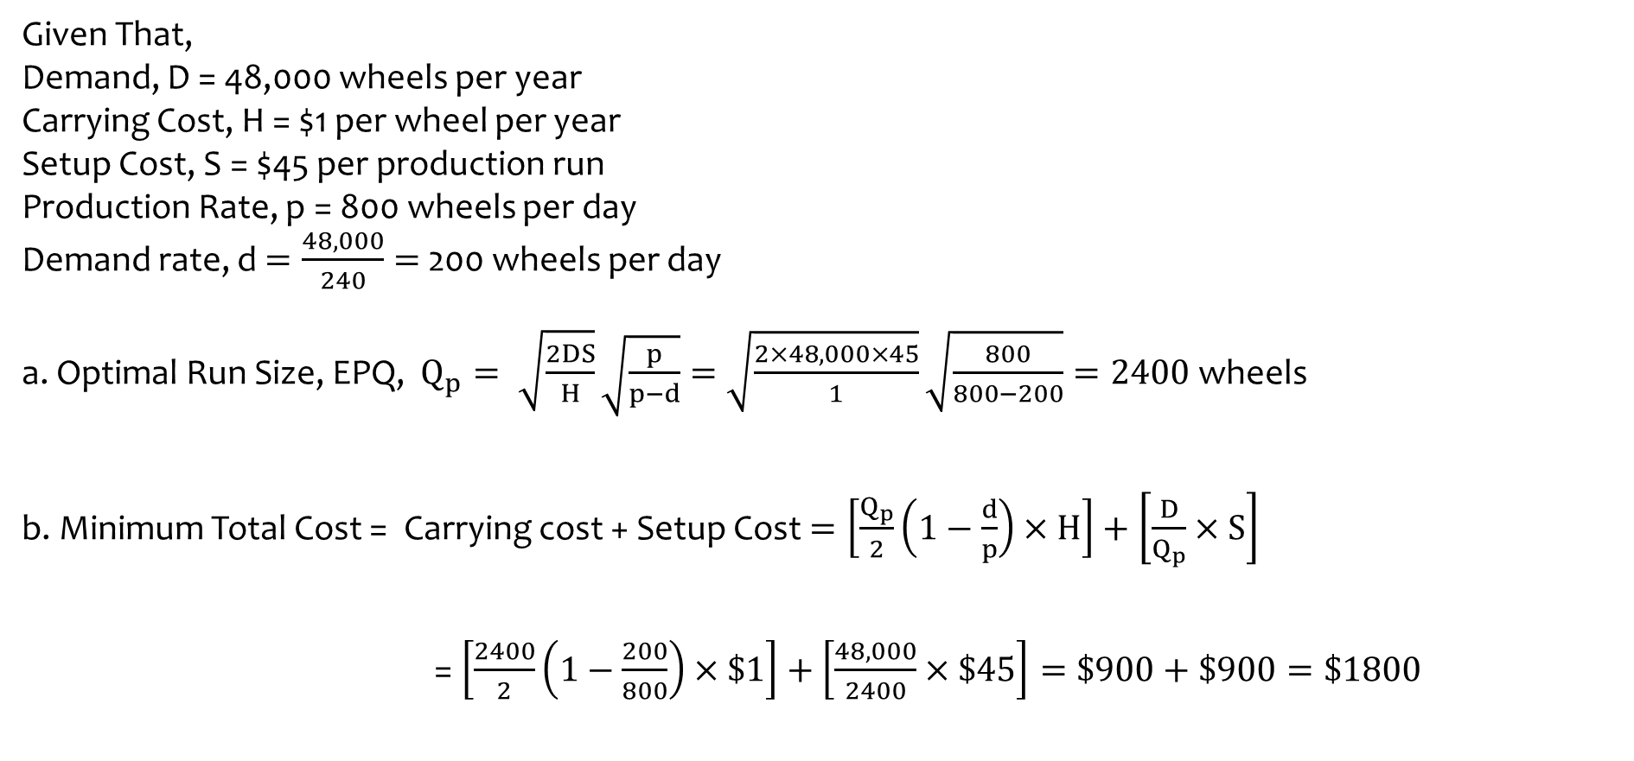
Solution of Example 3: EPQ
Given That,
Demand, D = 48,000 wheels per year
Carrying Cost, H = $1 per wheel per year
Setup Cost, S = $45 per production run
Production Rate, p = 800 wheels per day
Demand rate, d $=\frac{48,000}{240}=$ 200 wheels per day
a. Optimal Run Size, EPQ, $Q_{p}= \sqrt{\frac{2DS}{H}}\sqrt{\frac{p}{p−d}}=\sqrt{\frac{2×48,000×45}{1}}\sqrt{\frac{800}{800−200}}=2400$ wheels
b. Minimum Total Cost = Carrying cost + Setup Cost $=\left[\frac{Q_{p}}{2}\left(1−\frac{d}{p}\right)×H\right]+\left[\frac{D}{Q_{p}}×S\right]$
= $\left[\frac{2400}{2}\left(1−\frac{200}{800}\right)×\$1\right]+\left[\frac{48,000}{2400}×\$45\right]=\$900+\$900=\$1800$

Slide 35

Solution of Example 3: EPQ
c. Cycle time $=\frac{{ Q}_{p}}{d}=\frac{2400}{200}=12$ days
thus a run of wheels will be made every 12 days
d. Run time $=\frac{{ Q}_{p}}{p}=\frac{2400}{800}=3$ days
thus each run will require three days to complete

Slide 36
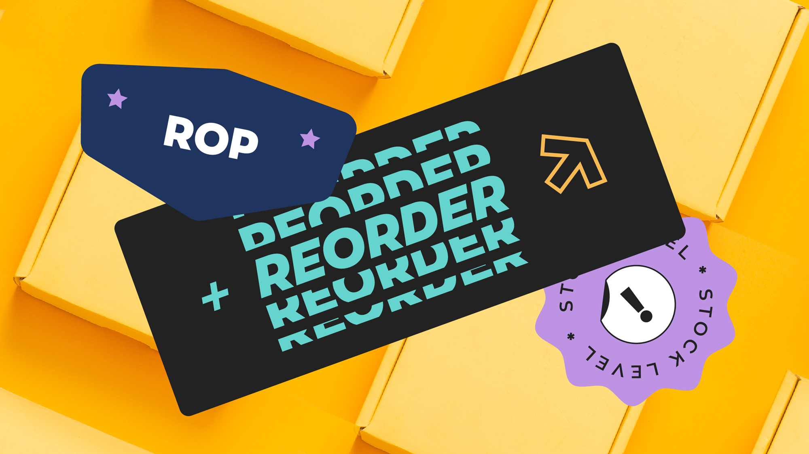
Reorder Point (ROP)
When the quantity on hand of an item drops to ROP amount,
the item is reordered

Slide 37
Determinants
of the
Reorder Point
The rate of demand
The lead time
The extent of demand and/or lead time variability
The degree of stockout risk acceptable to management

Slide 38
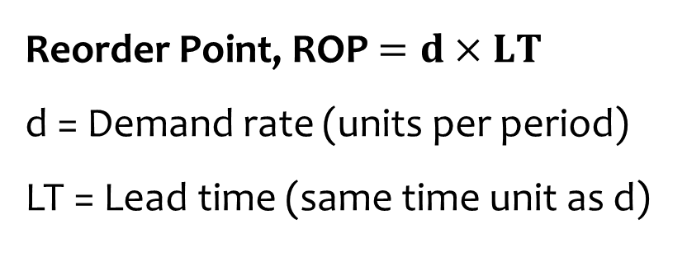
Reorder Point Under Certainty
Reorder
Point
Reorder Point, ROP $=d×LT$
d = Demand rate (units per period)
LT = Lead time (same time unit as d)
Reorder Stock
Stock
A
B
A – Reorder point
B – Material Received
Time
Lead Time
100 days

Slide 39
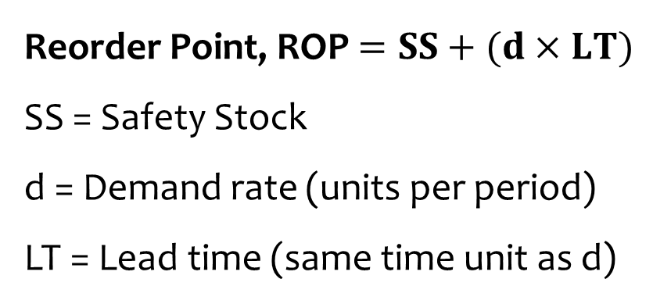
Reorder Point Under Certainty with Safety Stock
Reorder
Point
Reorder Point, ROP $=SS+(d×LT)$
SS = Safety Stock
d = Demand rate (units per period)
LT = Lead time (same time unit as d)
Reorder Stock
Stock
Safety Stock
A
B
A – Reorder point
B – Material Received
Time
Lead Time
100 days

Slide 40
Example 4: Reorder Point
A famous burger restaurant at Dhaka city has a daily demand of 100 burger buns. However, the burger bun supplier doesn’t provide the bun immediately, rather they take 2 days to deliver.
a. What would be the reorder point of the burger bun? b. If the restaurant decides to keep a safety stock of 80 burger buns, then what would be the reorder point in this case?
a. ROP = d x LT = 100 x 2 = 200 burger buns
b. ROP = SS + (d x LT ) = 80 + (100 x 2) = 280 burger buns

Slide 41
Quantity Discounts
A quantity discount is an incentive offered to a buyer that results in a decreased cost per unit of goods or materials when purchased in greater numbers.
If quantity discounts are offered, the buyer must weigh the potential benefits of reduced purchase price and fewer orders that will result from buying in large quantities against the increase in carrying costs caused by higher average inventories.
TC=Carrying cost+ Ordering cost+ Purchasing cost=(Q/2)H+(D/Q)S+PD; where P = Unit price

Slide 42
Quantity Discounts
A bicycle manufacturer sells bicycles at $10 in general. However it provides quantity discounts in the following way if the purchased quantity is higher
More than 1500 Qty
(1500+)
at $7
Impact of Achieving Quantity Discounts
3rd 500 Qty
(1001-1500)
at $8.5
Total Inventory Level
Per Unit Cost
Total Cost
No. of Orders
2nd 500 Qty
(501-1000)
at $9.3
1st 500 Qty
(0-500)
at $10

Slide 43
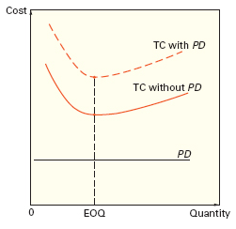
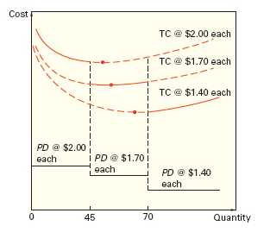
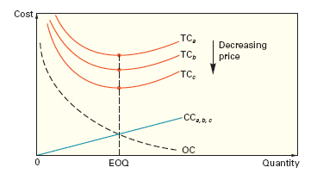





EOQ in Quantity Discount Cases
Total Cost, TC =Carrying cost+ Ordering cost+ Purchasing cost (PD)
= (Q/2)H + (D/Q)S + PD, where P = Unit price
Cost
Cost
Cost
TC @ $2.00 each
TC With PD
$${TC}_{a}$$
Decreasing Price
TC @ $1.70 each
TC Without PD
$${TC}_{b}$$
TC @ $1.40 each
$${TC}_{c}$$
$${CC}_{a,b,c}$$
PD @ $2.00 each
PD
PD @ $1.70 each
$$OC$$
PD @ $1.40 each
0
EOQ
Quantity
0
EOQ
Quantity
0
45
70
Quantity
Adding purchasing cost to the total cost doesn’t change the EOQ
EOQ increases with quantity discounts

Slide 44
Steps in Analyzing a Quantity Discount
For each discount, calculate Q*
If Q* for a discount doesn’t qualify, choose the smallest possible order size to get the discount
Compute the total cost for each Q* or adjusted value from Step 2
Select the Q* that gives the lowest total cost

Slide 45
Example 5: Quantity Discount Model
A typical quantity discount schedule of a car manufacturer is given below. The annual demand is 5,000 unit of cars. The holding cost is 20% of the purchasing cost and the ordering cost is $49 per order. Determine the EOQ.
Discount Number | Discount Quantity | Discount (%) | Discount Price (P)
1 | 0 to 999 | no discount | $5.00
2 | 1,000 to 1,999 | 4 | $4.80
3 | 2,000 and over | 5 | $4.75

Slide 46
Solution of Example 5: Quantity Discount Model
Total cost curve for discount 2
Total cost curve for discount 1
Total cost $
Total cost curve for discount 3
b
a
Q* for discount 2 is below the allowable range at point a and must be adjusted upward to 1,000 units at point b
1st price break
2nd price break
0
1,000
2,000
Order quantity

Slide 47
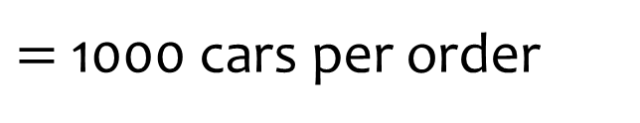
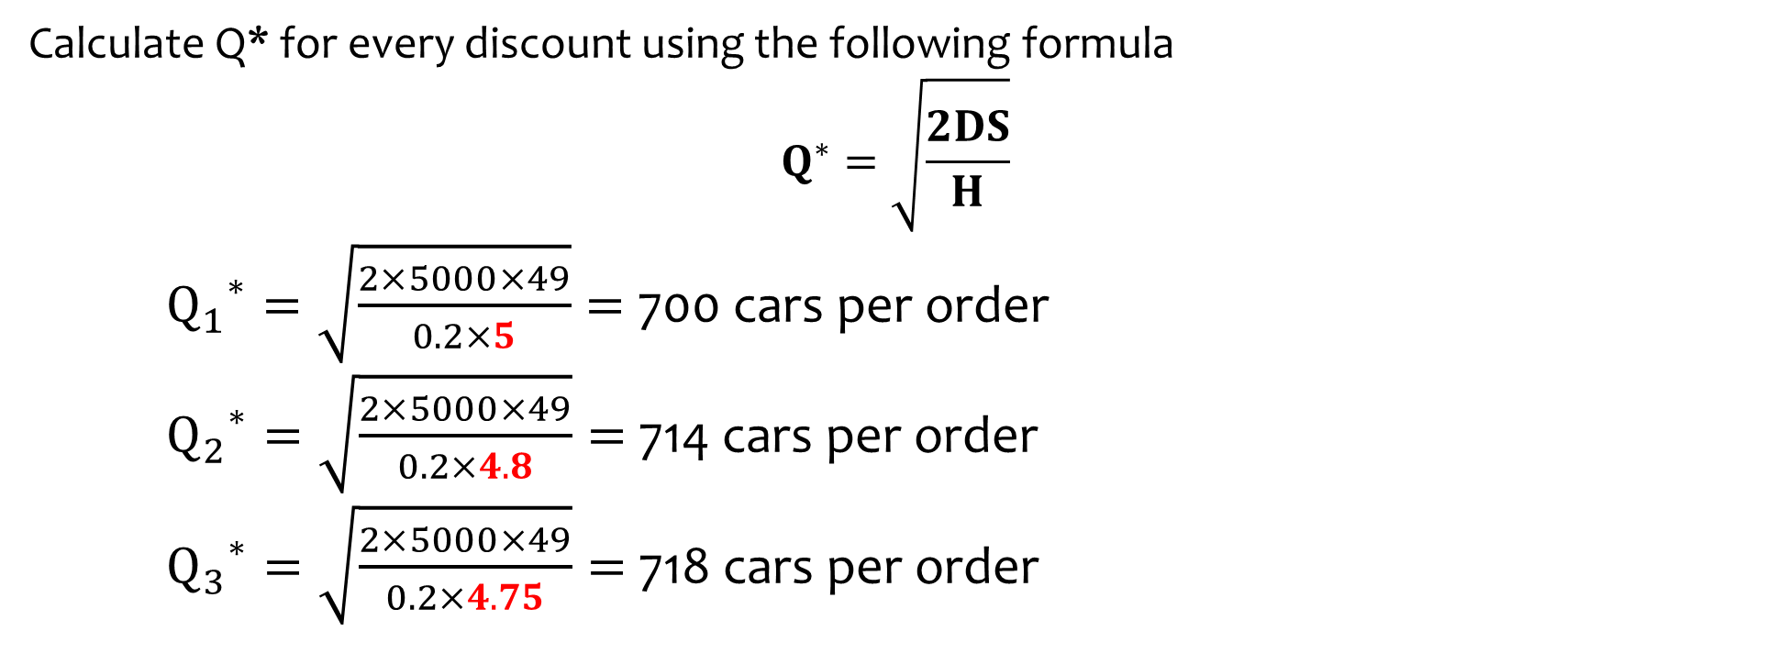
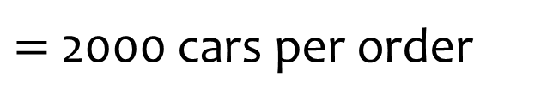
Solution of Example 5: Quantity Discount Model
Calculate Q* for every discount using the following formula
$$Q^{∗}=\sqrt{\frac{2DS}{H}}$$
${Q_{1}}^{∗}=\sqrt{\frac{2×5000×49}{0.2×5}}=$ 700 cars per order
${Q_{2}}^{∗}=\sqrt{\frac{2×5000×49}{0.2×4.8}}=$ 714 cars per order
${Q_{3}}^{∗}=\sqrt{\frac{2×5000×49}{0.2×4.75}}=$ 718 cars per order
$=$ 1000 cars per order
$=$ 2000 cars per order

Slide 48
Solution of Example 5: Quantity Discount Model
Annual Demand, D = 5,000 Ordering Cost, S = $49 per order Holding Cost, H = 20% of Purchasing Cost
Discount Number | Unit Price, P | Order Quantity, Q | Annual Product Cost, P x D | Annual Ordering Cost, (D/Q) x S | Annual Holding Cost, (Q/2) x H | Total
1 | $5.00 | 700 | $25,000 | $350 | $350 | $25,700
2 | $4.80 | 1,000 | $24,000 | $245 | $480 | $24,725
3 | $4.75 | 2,000 | $23.750 | $122.50 | $950 | $24,822.50
∴ EOQ = 1000 units at $4.80

Slide 49


